Slide 1
Expand the Cluster Analysis to other Data
Create a clean/full dataset
Used the BLS API to bring in many series for each Index/Survey (PPI, CPI, CES)
Applied text analysis techniques to combine series with different classification systems
Clustered CPI and CES data by industry series (same approach as with PPI)
Compared/contrasted the resulting clusters

Slide 2
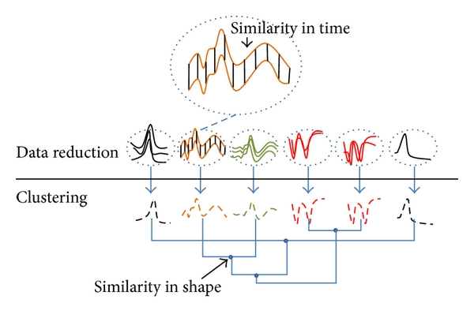
Cluster Results and Comparisons
Difficulties in measuring the results
Unsupervised machine learning means an unknown label
Challenges in applying the K-means clustering to this data
Challenges in developing metrics to compare the different clusters across different data sources
Other clustering algorithms were tested
Based on shape/trends instead of point distances
Types: K-means, Hierarchical, Dynamic Time Warping, Motif

Slide 3
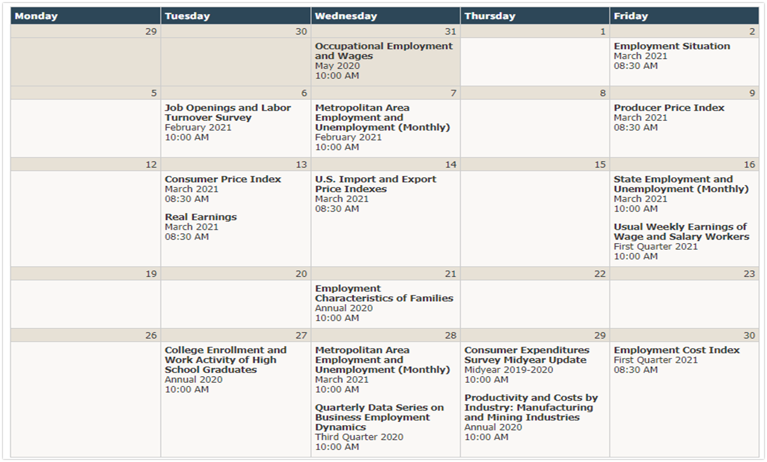
How can this cluster analysis be used?
Inform other classification or regression models
Feature selection and parameter tuning
One possible use case: inform a prediction model based on data release schedule
Some initial tests of using our clusters in a classification model

Slide 4
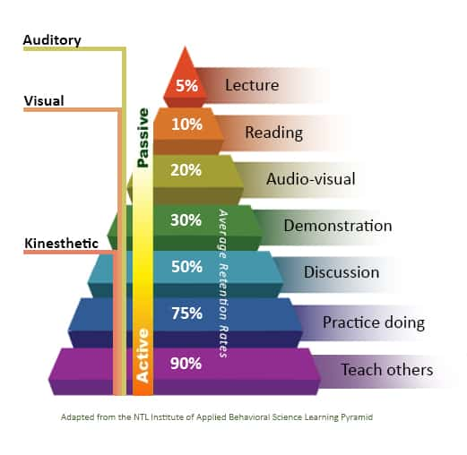
Capstone Summary
Other applications of this project and potential future work
Validation/assessment metric of new data and collection methodologies (e.g., does the series continue to follow other series in the cluster?)
Apply similar clustering analysis to other data sources
The true value of the capstone
Opportunity to practice a large variety of machine learning techniques and new tools
Had to work through hard problems: what is the problem we want to solve, what does our data need to look like, what algorithm would work best, etc.?

Slide 5
Questions

Slide 6
Run of Show
Welcome and Housekeeping – 1-2 Minutes – Christian
Program Overview – 2-3 Minutes – Christian
Agency Teams Introductions & Comments – 1-2 Minutes – Team Spokesperson
Agency Capstone Presentation – 10 – 15 Minutes – Team Members (Each member should have a speaking role)
Opportunity for Q&A – 5 – 7 minutes – Agency Invitees
Session Wrap Up – 1-2 Minutes - Christian

